Slide 1
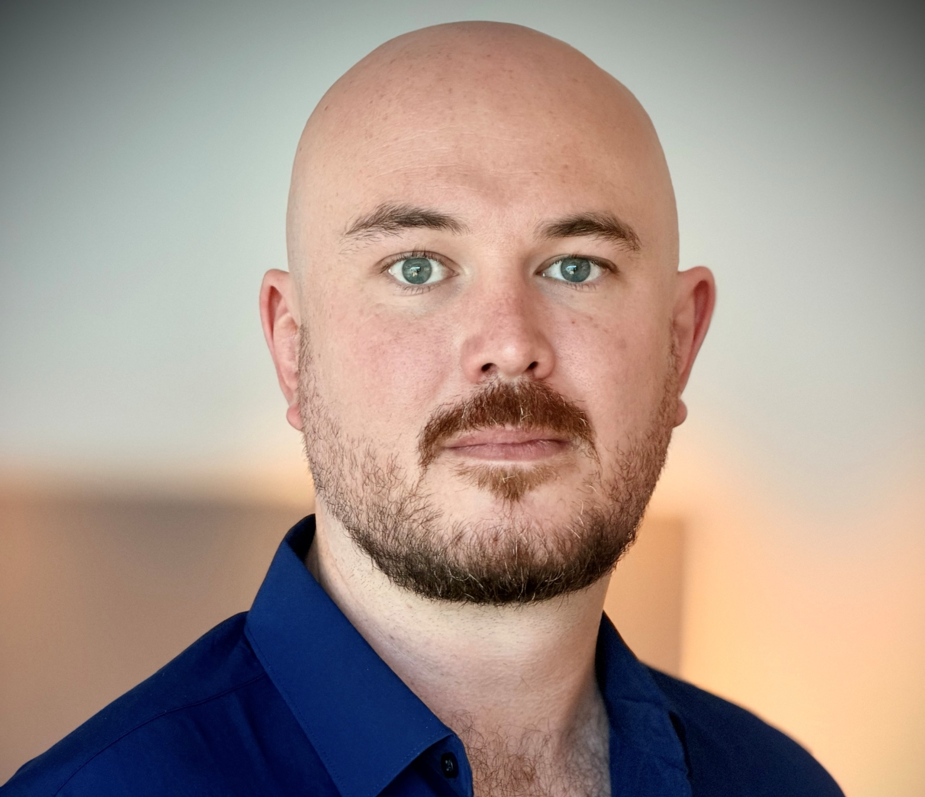


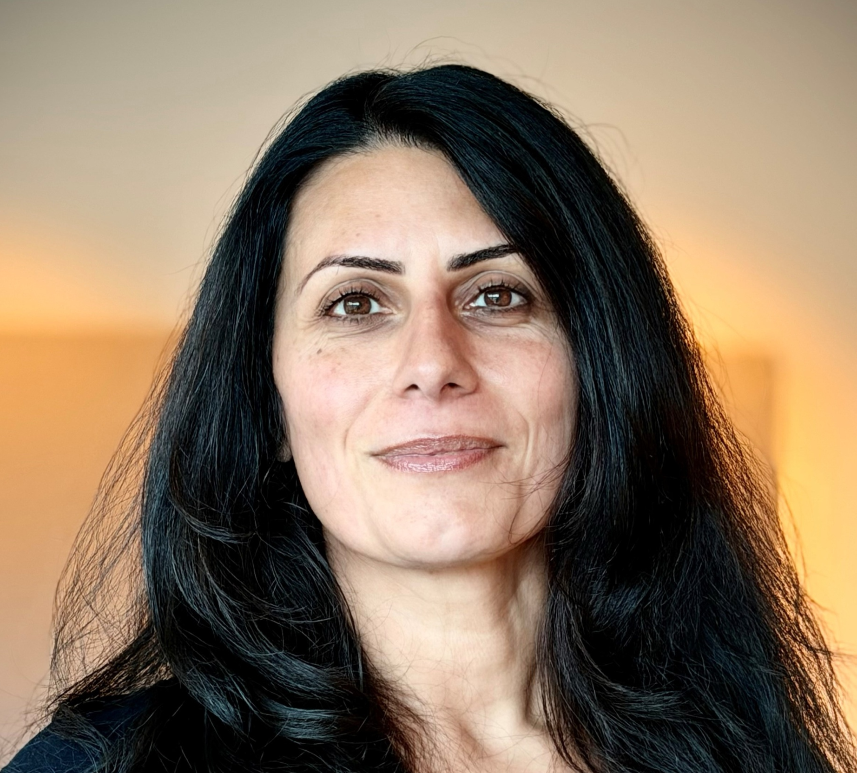
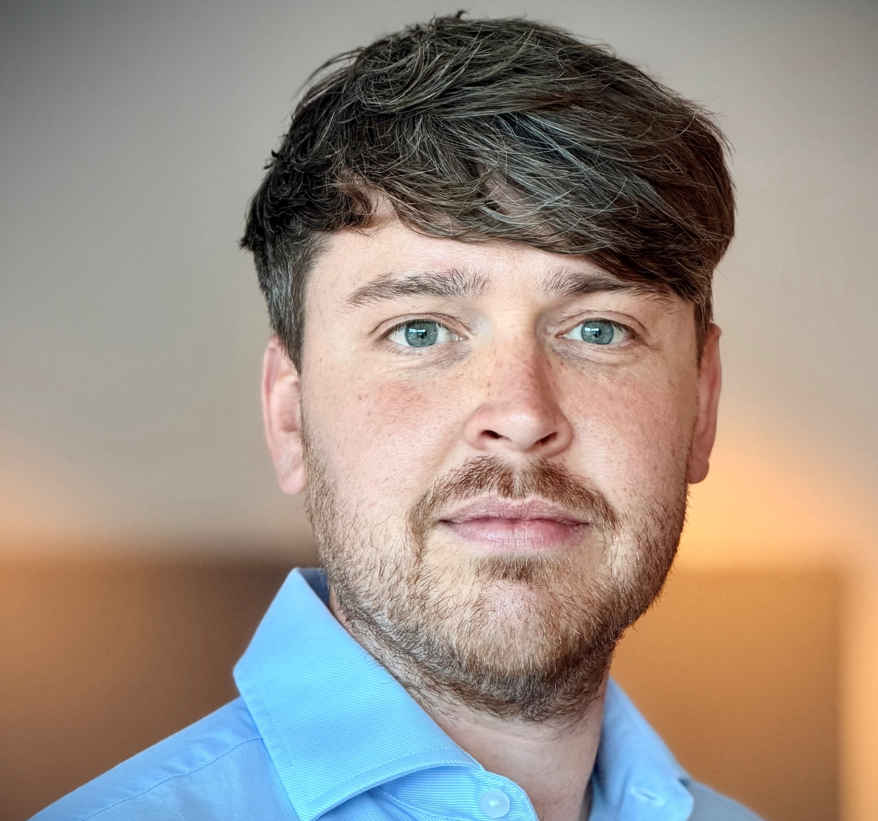
Introducing the trading team
Robbie Moore
Trading Director
Simon Chadwick-Zeff
Head of Trading
Chez Montasser
Head of Trading
Josh Williams
Head of Trading

Slide 2
Trading Leadership team
Wholesale Trading Director
Robbie Moore
Head of Trading: Impulse, Grocery & Bulk
Josh Williams
Head of Trading: Licensed, Tobacco & Direct
Simon Chadwick-Zeff
Head of Trading: Fresh, Frozen & Non-Food
Chez Montasser
Head of Operations
LJ Hanson
Head of Supply
Naomi Murray
Business Assistant
Ellouise Seppings

Slide 3
impulse, grocery & bulk
Head of Trading
Josh Williams
Senior Category Manager – Bulk
Ryan Hibbert
Senior Category Manager – Impulse
Rachael Grist
Category Manager – Biscuits, Crisps & Snacks
Rebecca Huxtable
Category Manager –Seasonal
Alana Reeves
Category Manager – Confectionery
Joanna Foxsmith 13th
Category Manager – Soft Drinks
Myles Catton
Senior Category Manager - Grocery
Bella Broker
Category Manager – Core Grocery
Caroline Rose
Category Manager – Cereals, Hot Bevs, Home Baking
Emily Furlong

Slide 4
licensed, tobacco &
DIRECT TO STORE
Head of Trading
Simon Chadwick-Zeff
Senior Category Assistant Impulse & Lic
Debbie Butler-Healey
Category Assistants:
Iga Dymowska
Kirsty Hudson
Emily Cubitt
Laura Mitchell
Rebecca Potter
Pauline Catley
Imogen Fletcher
Senior Category Manager – BWS
Steve Evans
Category Manager – Beer
Mark Land
Category Manager – Spirits
Donna Powell
Category Manager – Wine
TBC
Senior Category Manager – Kiosk & Tobacco
Wayne K
Category Manager – DTS
Samantha Rusling
Category Assistant – DTS
Millie Hunt

Slide 5
FRESH, FROZEN & NON-FOOD
Head of Trading
Chez Montasser
Senior Category Assistant F&F & Grocery
Jennifer Pattison
Category Assistants:
Lilly Moss
Cara Williams
Caroline Grant Bernadette Garland
Senior Category Manager – Fresh & Frozen
Stephen Paine
Category Manager – Dairy, Bakery & Juice
Ian Redhead
Category Manager – Produce & Protein
Darren Hamilton
Category Manager – Ready Meals & Pizza
Johannes Trosee
Category Manager – FTG
Millie Davies
Category Manager – Frozen & World
David Balfour - Mears
Senior Category Manager – Non Ed
Rebecca Holloway
Category Manager – Non-Edible
Alisha Proctor
Category Manager – Non-Food
Georgia Greening

